Slide 1
ALZHEIMER DISEASE PREDICTION USING DEEP LEARNING TECHNIQUE
- Shakil S(312419104127)
- Sridharshini M (312419104140)
- Guide: Mr. A.Deepak Kumar,(Ph.D.)

Slide 2
Introduction :
Alzheimer’s disease is an unpredictable degenerative brain disease.
Every 4 seconds someone in the world is diagnosed with Alzheimer’s disease the result is fatal as it leads to death.
The leading cause of dementia is AD, dementia causes a reduction in reasoning abilities and interpersonal coping skills and abilities to function independently.
The patient will forget the recent events in the early stage if the illness progresses they will gradually forget the whole event.
Therefore, diagnosing the disease as soon as possible is essential.
A model that takes a brain MRI sample image as input and determines whether a person has mild, moderate, very mild, or no dementia disease as output.

Slide 3
Abstract :
Alzheimer’s disease (AD) is the most common cause of dementia globally. It steadily worsens from mild to severe, impairing one’s ability to complete any work without assistance.
It begins to outstrip due to the population ages and diagnosis timeline. For classifying cases, existing approaches incorporate medical history, neuropsychological testing, and Magnetic Resonance Imaging (MRI), but efficient procedures remain inconsistent due to a lack of sensitivity and precision.
By considering four stages of dementia and conducting a particular diagnosis, the proposed model generates high-resolution disease probability maps from the local brain structure to a multilayer perceptron and provides accurate, intuitive visualizations of individual Alzheimer’s disease risk.
A DenseNet169 algorithm classification is proposed to detect the dementia stages from MRI. Which is superior to existing methods, we also used the Alzheimer’s disease Neuroimaging Initiative (ADNI) dataset to predict AD classes in order to assess the efficacy of the proposed model.

Slide 4
Literature Survey :
S. No | Year & Author name | Title | Description | Advantages | Disadvantages
1. | 2018, Mr. S. Siva Prakash, et.al. | Volumetric Feature-Based Alzheimer’s Disease Diagnosis From MRI Data Using a Convolutional Neural Network and a Deep Neural Network | Detail analysis and provided a formal description of the articulated classification problem involved. | A large importance to feedbacks is given during the learning problem. | Classifiers trained on feedbacks and delayed supervised samples.
2. | 2018, Jurriaan Besenbruch. | Feature Extraction and Identification of Alzheimer’s disease based on Latent Factor of Multi-Channel EEG | The first approach is based on traditional classifiers, the second approach utilizes deep Neural networks. | Resampling always improves the classification performance. | No self-evident which sampling strategy works best.
3. | 2018, Lakshmi S V S S ,et.al. | Prediction of Alzheimer’s Disease Progression with Multi-Information Generative Adversarial Network. | This paper investigates the performance of logistic regression, decision tree and random forest for credit card fraud detection. | By comparing all the three methods, it is found that the random forest classifier is better. | The analysis is performed for a large dataset, the algorithm fails to prove its accuracy for a smaller dataset.

Slide 5
S. No | Year & Author name | Title | Description | Advantages | Disadvantages
4. | 2018, I.Sadgeli, et.al. | Relation-induced Multi-modal Shared Representation Learning for Alzheimer’s disease Diagnosis. | Comparative analysis of different machine learning algorithms | Hybrid fraud detection techniques are the most used. | The studies do not smother all types of fraud.
5. | 2019, Pradheepan Raghavan, et.al. | Combining of Multiple Deep Networks via Ensemble Generalization Loss, Based on MRI Images, for Alzheimer’s disease Classification | This paper aims to benchmark multiple machine learning and deep learning methods. | CNN works fine for large dataset whereas Random forest and KNN works better for small dataset. | Does not work well for dynamic environments.
6. | 2019, Nishant Sharma. | Machine Learning and Deep Learning Approaches for Brain Disease Diagnosis: Principles and Recent Advances. | Performs comparative analysis of random forest, AdaBoost, XGBoost and LightGBM. | XGBoost Classifier has 97% accuracy. | Like any other boosting method, XGB is sensitive to outliers.
7. | 2019, Stephen Coggeshall. | A Comprehensive Fuzzy Ontology-Based Decision Support System for Alzheimer’s disease Diagnosis | Five different supervised models used are logistic regression, neural networks, random forest, boosted tree and support vector machines. | The boosted tree model shows the best fraud detection result (FDR = 49.83%) for this particular data set. | The non-linear models slightly outperform the linear model, except for the artificial neural network.

Slide 6
S. No | Year & Author name | Title | Description | Advantages | Disadvantages
8. | 2019, Muhammad Zeeshan Younas. | DEMNET: A Deep Learning Model for Early Diagnosis of Alzheimer Diseases and Dementia from MR Images | The first approach is based on traditional classifiers,the second approach utilizes deep neural networks. | Utilizes waikato environment for knowledge analysis (WEKA) tool. | The paper is focused only on the machine learning and the accuracy is low.
9. | 2019, Devi Meenakshi, et.al. | Anatomical Landmarks and DAG Network Learning for Alzheimer’s disease Diagnosis | Provides essential features required to detect fraudulent. | Random forest algorithm is very stable. | Speed during testing and application will suffer.
10. | 2019, Bavadharani. G, et.al. | Resting State fMRI and Improved Deep Learning Algorithm for Earlier Detection of Alzheimer’s Disease. | Hybrid methods which use AdaBoost and majority voting methods are applied. | Algorithms for clustering and classification were used separately. | Lack of confidentiality and lack of security of data.
11. | 2019, Kaithekuzhical Leena Kurien, et.al. | Machine Learning and Deep Learning Approaches for Brain Disease Diagnosis: Principles and Recent Advances. | Describes probability of fraudulent transactions in prevalence and context of credit card usage. | Can handle large datasets helps in predicting the disease efficiently. | The customers credit card passwords, cvv numbers and other vital information are always vulnerable.

Slide 7
S. No | Year & Author name | Title | Description | Advantages | Disadvantages
12. | 2020, K.Ratna Sree Valli et.al | Alzheimer disease detection using Machine learning algorithms | Here different machine learning algorithms on an imbalanced with ensemble classifiers using boosting techniques are implemented. | Random forest with boosting shows that it proves accurate in detecting disease. | By using the three algorithms we cannot determine the names of fraud and non-fraud transactions for the given dataset using machine learning.
13. | 2021, Kartik Madkaikar, et.al | Prediction of Alzheimer’s Disease Progression with Multi-Information Generative Adversarial Network. | Several algorithms and neural networks were used. | Gradient boosting has the highest accuracy. | Gradient boosting can over emphasize outliers and cause overfitting.
14. | 2022, Emmanuel Ileberi, et.al | A machine learning based Alzheimer detection using the GA algorithm for feature Selection | The GA was implemented with the RF in its fitness function. | GA selected attributes demonstrated that the GA-RF achieved an overall optimal accuracy of 99.98%. | The algorithm works accurately for a limited amount of dataset only.
15. | 2022, Abdulalem Ali, et.al | Alzheimer Detection Based on Machine Learning: A Systematic Literature Review | The paper attempts to present a systematic literature review (SLR) on machine learning (ML)-based fraud detection. | The paper presented the key issues, gaps, and limitations in the area of financial fraud detection. | The paper fails to pay attention to unsupervised practices,which can uncover new insights.

Slide 8
Existing System :
The Existing model used a Machine Learning algorithm with psychological parameters like age, number of visits, MMSE, and some other features and by making use of all these they have created an ML model.
Existing Systems used algorithms such as Support Vector Machine(SVM), Decision Tree algorithms for classifying Alzheimer’s disease.
Using all the above approaches they ended up achieving low accuracy.
In the existing they also used the VGG19 model to classify Alzheimer’s disease in which the vanishing gradient problem is raised.
Also, Feature Propagation is not strengthened and the Reusability of the feature is not enhanced.
They did not take a step to reduce the number of parameters.

Slide 9
Proposed System :
Here, we explore DL Algorithms to identify and diagnose Alzheimer’s disease using MRI images of the human brain.
We collect the datasets from an open-source website called Kaggle. The dataset holds MRI images of the human brain in the affected person. For each category, we use 50 datasets.so a total of 200 datasets have been taken.
After the data set collection and pre-processing methods, we use and apply the following deep learning algorithms – Densenet169 algorithm classification for AD diagnosis.
This is an effective algorithm due to its better size and accuracy.
When the image is given as input It passes through a sequence of layers of dense blocks after every dense block layer there is a transition layer, convolutional layer, and Pooling layer which enhances the image pixels and reduce the size.

Slide 10
Proposed System Advantage:
Vanishing Gradient problem is alleviated by Densenet
Feature Propagation is strengthened
Reusability of feature is enhanced.
Number of the parameter is reduced.
Making use of all these we built this project to achieve high accuracy.

Slide 11
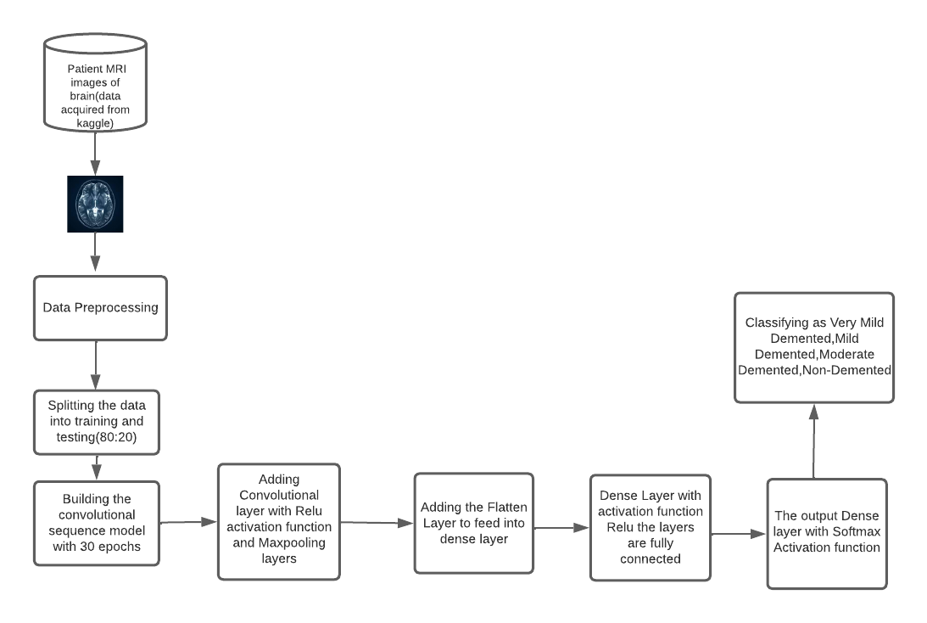
Proposed System Architecture :

Slide 12
LIST OF MODULES
Data acquisition
Image preprocessing
Magnetic resonance imaging classification
Densenet 169

Slide 13
MODULE 1-DATA ACQUISITION:
​The first step is to acquire images. To produce a classification model, the computer needs to learn by example. The computer needs to view many images to recognize an object. Other types of data, such as time series data and voice data, can also be used to train deep learning models.
In the context of the work surveyed in this paper, the relevant data required to detect Alzheimer disease will be images. The output of this step is images that will later be used to train the model.

Slide 14
MODULE 2-IMAGE PRE-PROCESSING:
​An image classification task determines the category of a given input MRI image. It is a basic task in high-level image understanding and can be divided into binary- and multi classification tasks. After multiple convolution-and-pooling operations via a CNN, an image is classified in the output layer following the requirements.
Activation function of the output layer is the only difference between binary and multi classification tasks. An image classification task for MRI image analysis easily identified and then necessary actions can be taken to which type of dementia, is a high performance in natural image classification, including Convolution neural network (CNNs) can be used in JPG/PNG image classification

Slide 15
MODULE 3-MAGNETIC RESONANCE IMAGE CLASSIFICATION:
This imaging technique utilizes radio waves and magnetic fields to generate high-quality and high-resolution 2D and 3D images of brain structures. No harmful radiations from X-rays or radioactive tracers are generated. The most commonly used MRI for AD cases is the structural MRI, which measures brain volumes in vivo to detect brain degeneration (loss of tissue, cells, neurons, etc.).
Brain degeneration is an inevitable progressive component of AD. A structural MRI used to detect brain atrophy. Alternatively, Functional Magnetic Resonance Imaging (fMRI), a widely used method to measure human primary visual cortex and detect brain topography.
fMRI provides useful information and data about the human brain’s activity, i.e., how the brain functions. fMRI methods, such as brain imaging based on arterial Blood Oxygenation Level Dependent (BOLD) contrasts and spin-labelling (ASL), are sensitive to the cerebral metabolic rate of oxygen consumption and cerebral blood flow (CBF).

Slide 16
MODULE 4-DENSENET169:
Densenet169 is among the major models of the Densenet group for image classification. The model is fairly popular due to it is better to size and accuracy. It is an output classifier object for 1000 varying classifications present in the ImageNet. The Densenet model has shown decent accuracy in the classification of images. The model has displayed certain promising graphs. It used a batch size of 128. The model has run for 40 epochs.
The model provided an accuracy of about 87% in the train data and about 80% in the test data. The model displayed an AUC of about 88% in train data and about 82% in the test data and the model loss obtained is also pretty low. After going through certain layers, the model classifies the images accordingly. The classification done is of four types namely Mild Demented, Moderate Demented, Non Demented and Very Mild Demented. The model displayed an accuracy of about 87% on the train dataset and an accuracy of about 78% on the test dataset.

Slide 17


Slide 18
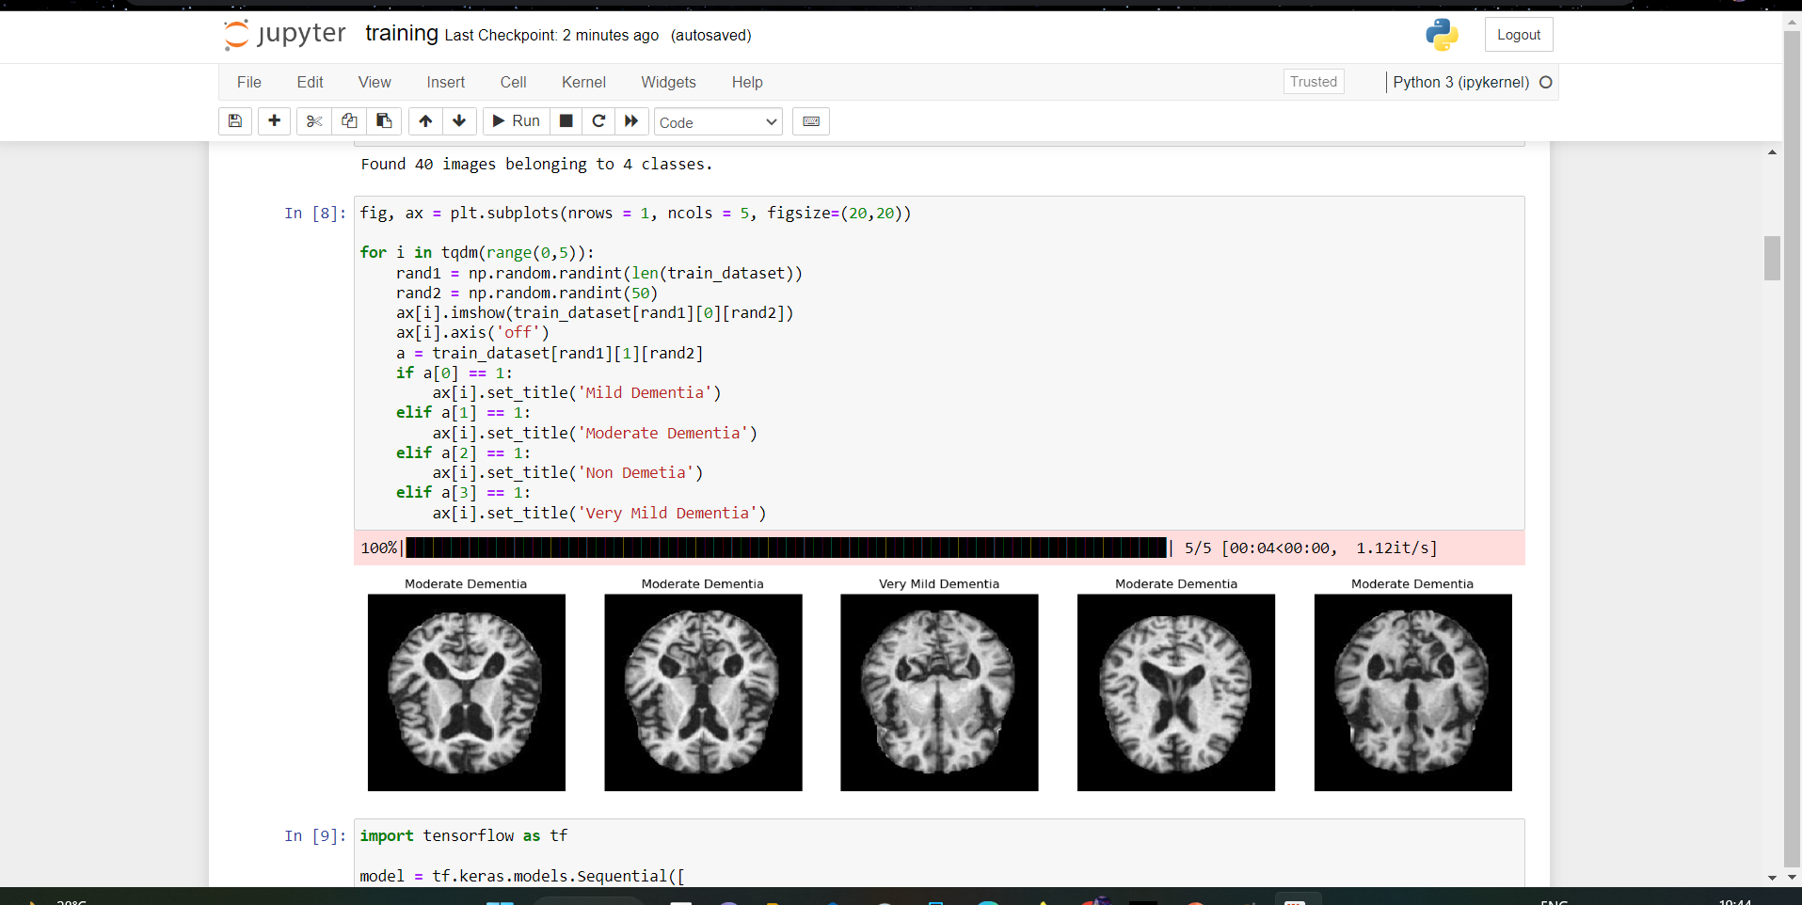

Slide 19
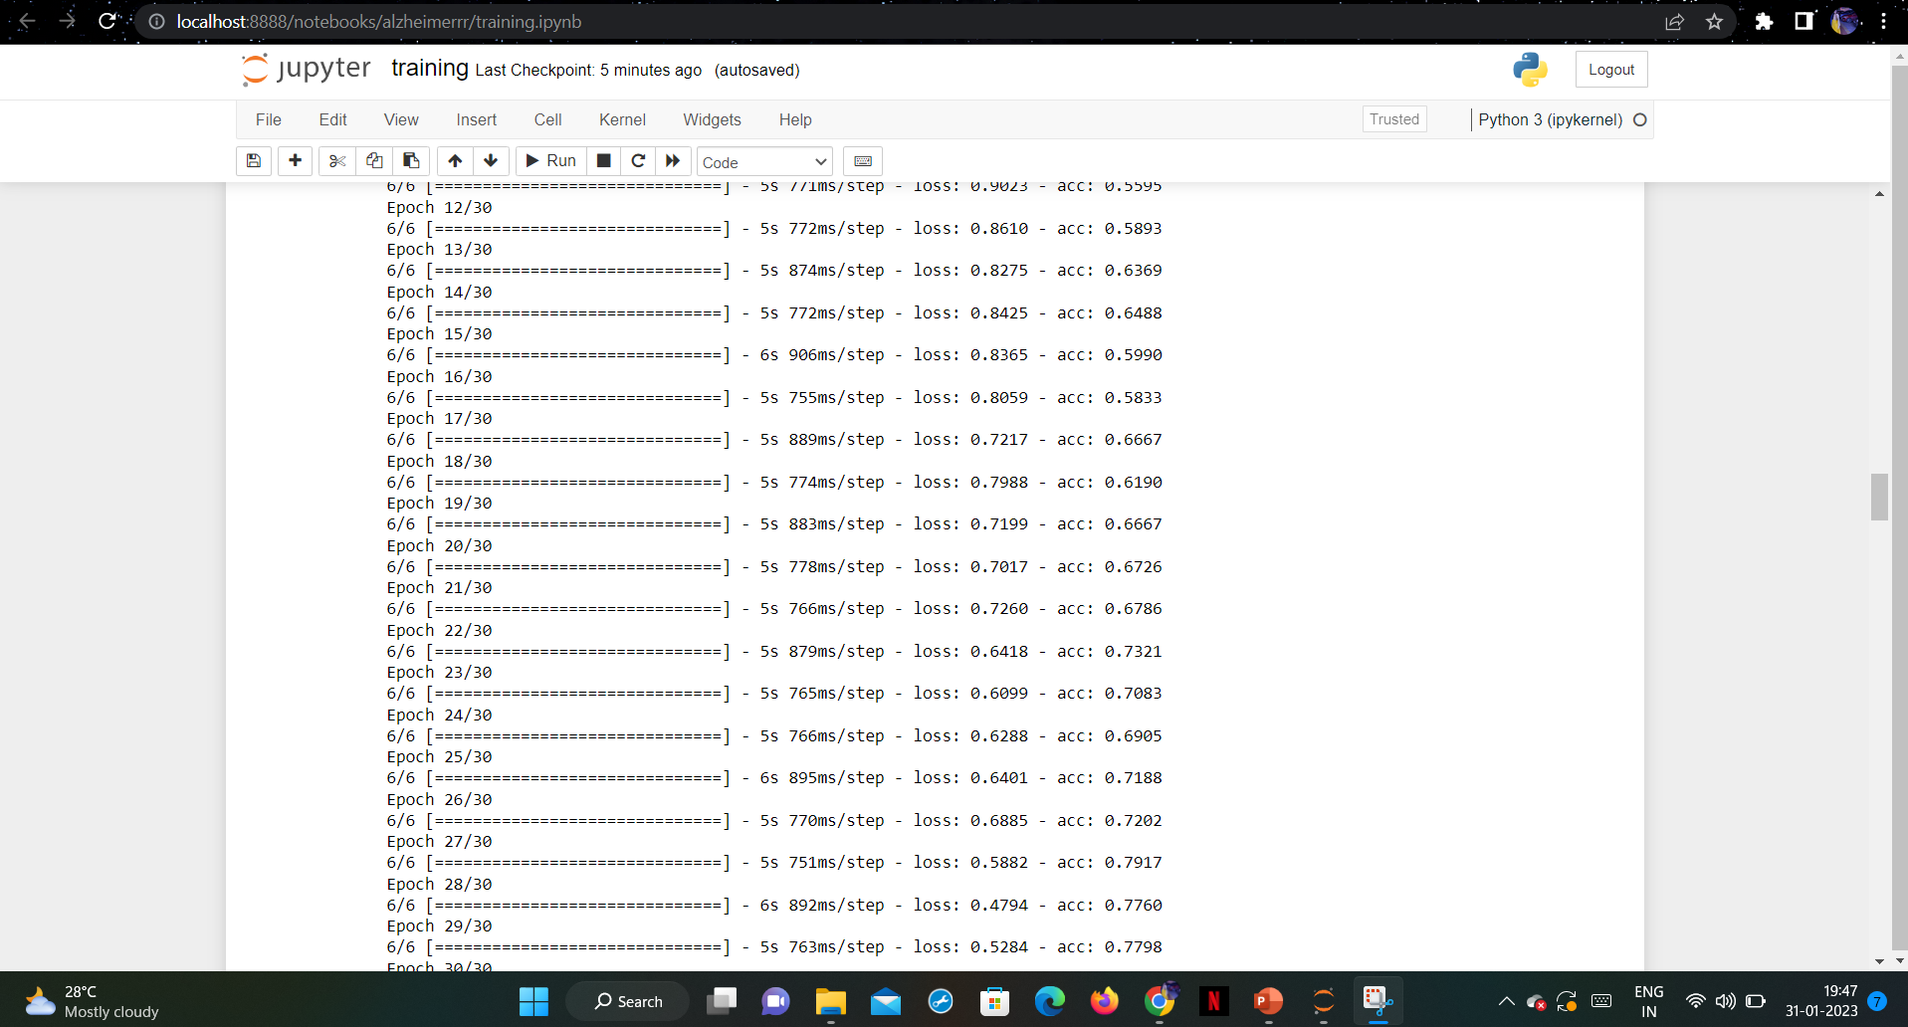

Slide 20
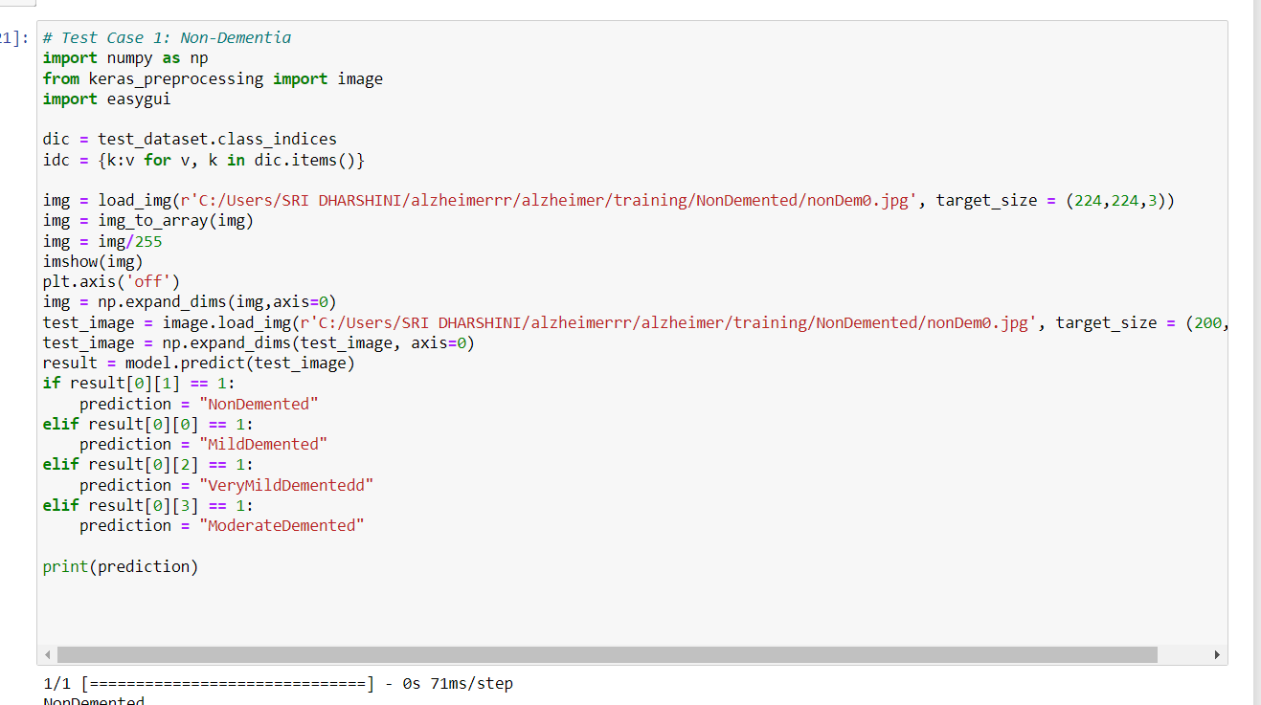

Slide 21
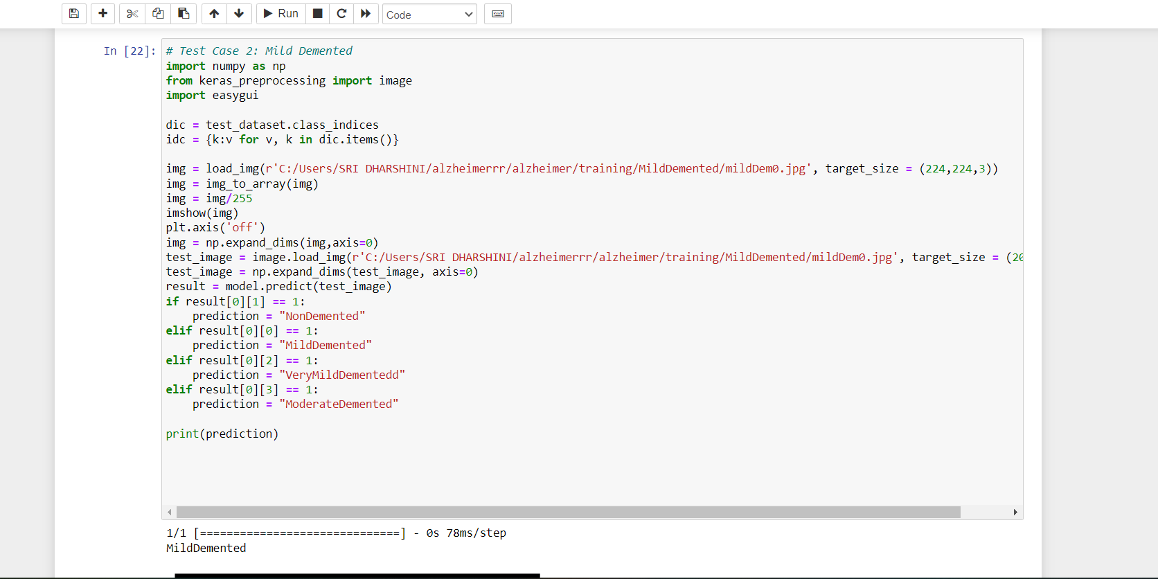

Slide 22
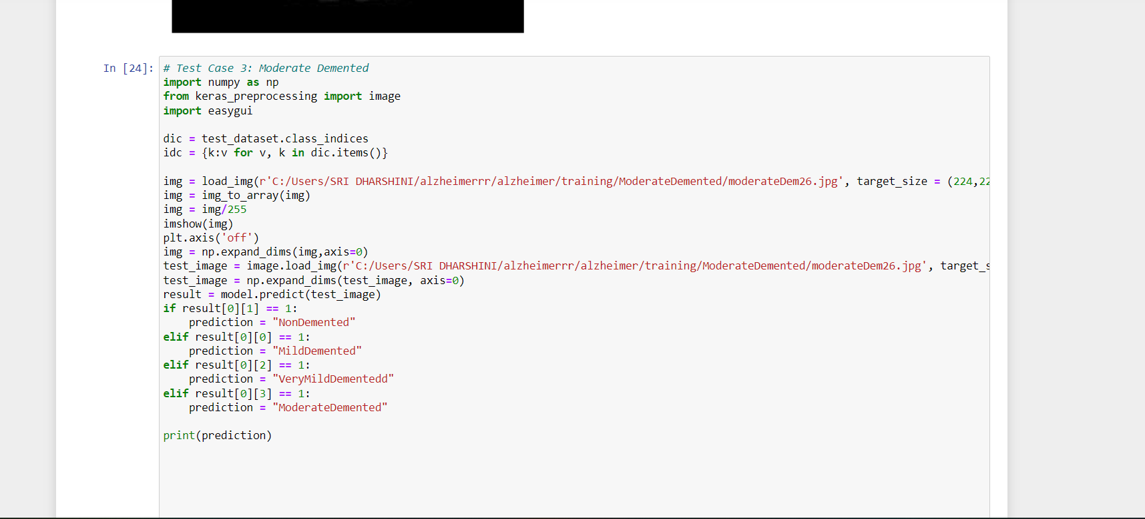

Slide 23
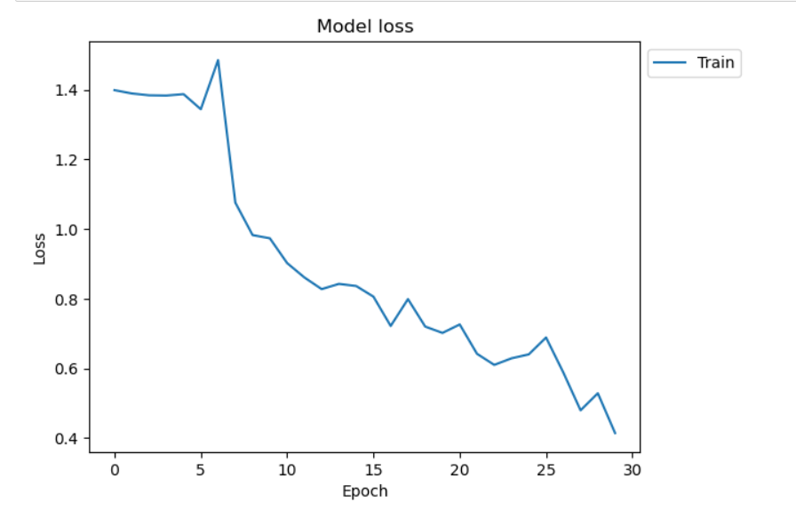
Performance Analysis :
The performance analysis of the DL algorithm are as follows :

Slide 24
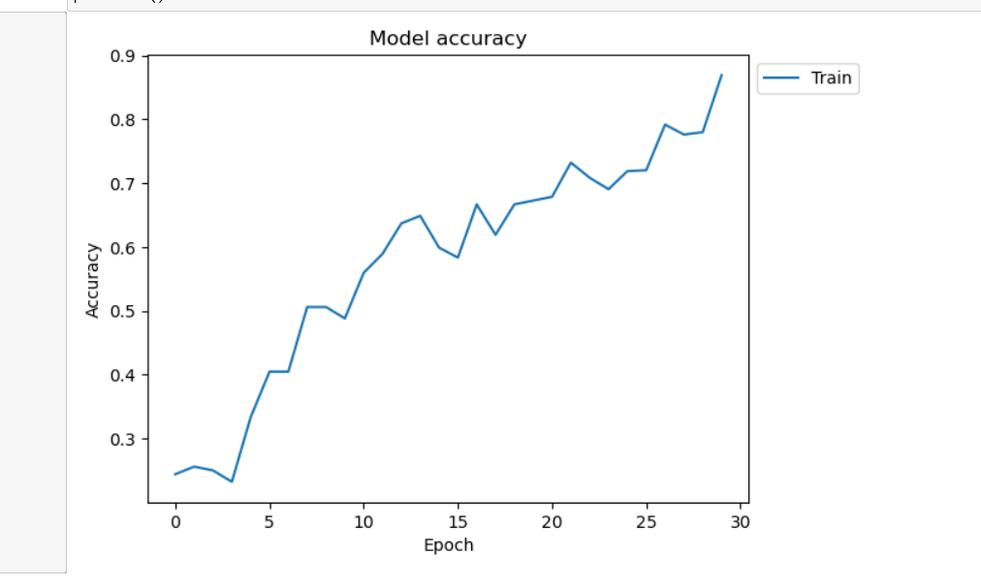

Slide 25
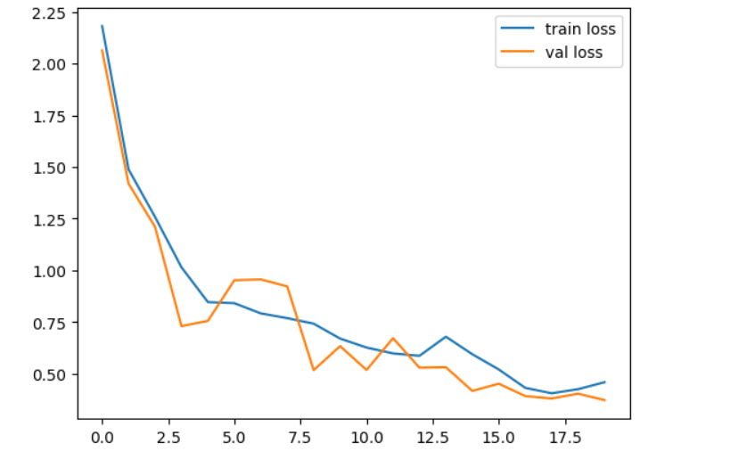
VGG16

Slide 26
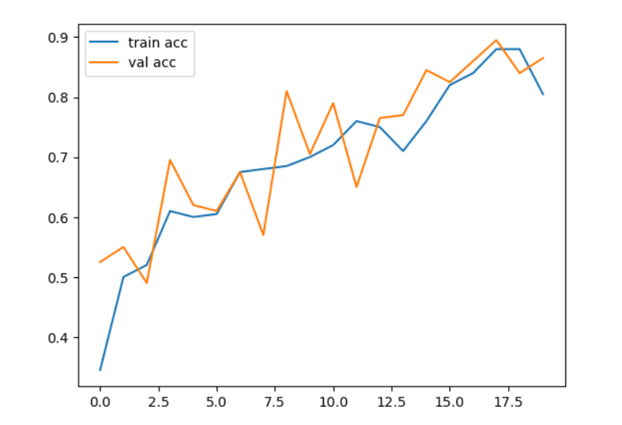

Slide 27
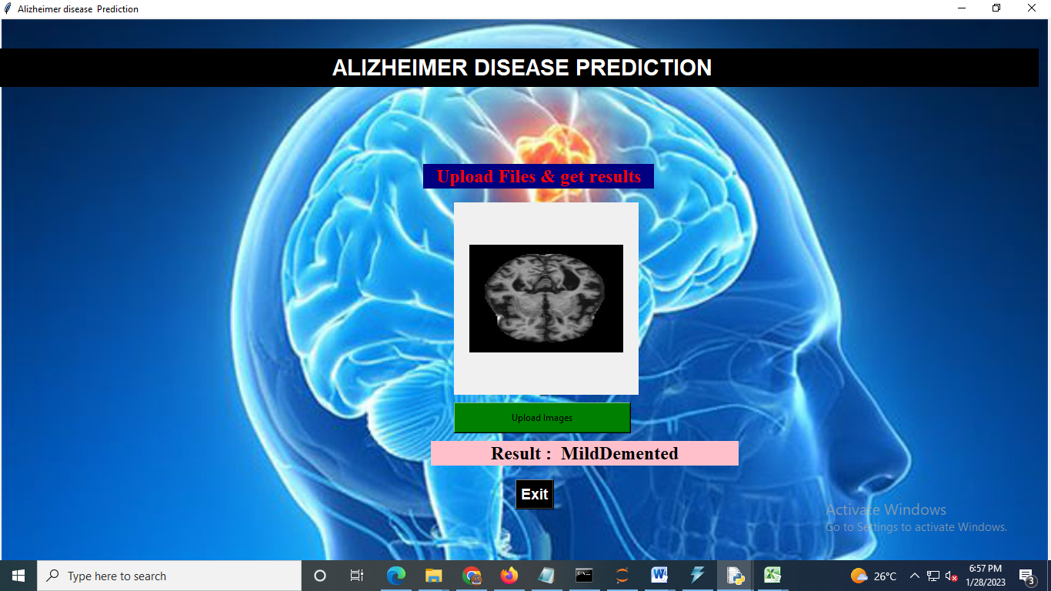
Output:

Slide 28
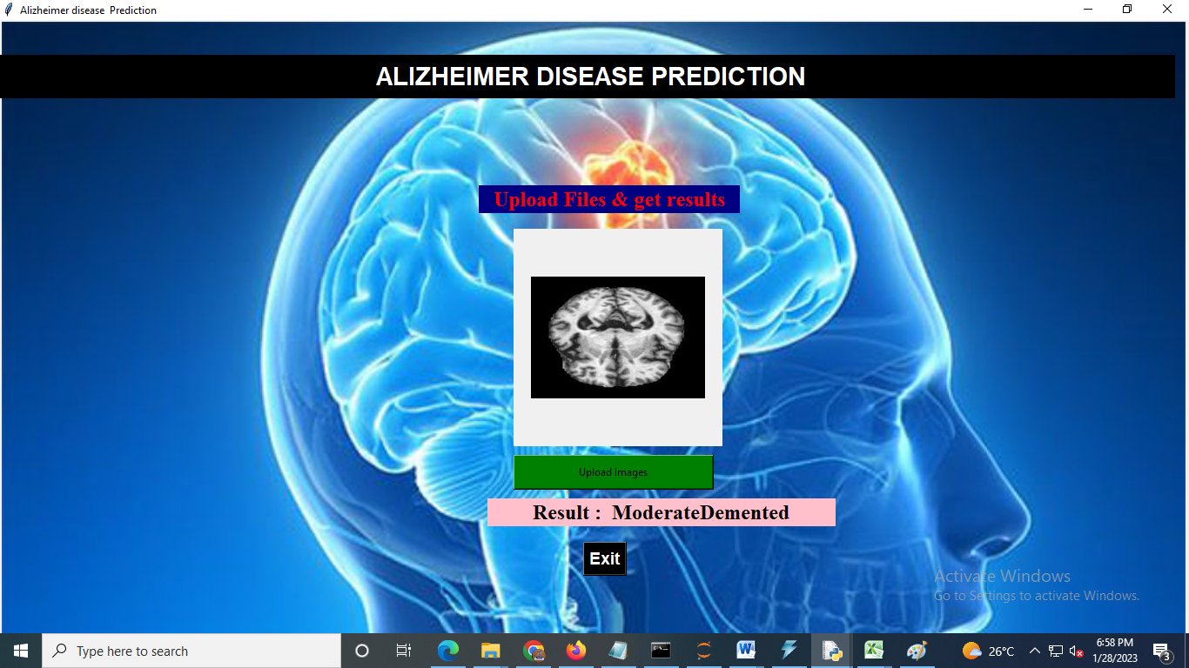

Slide 29
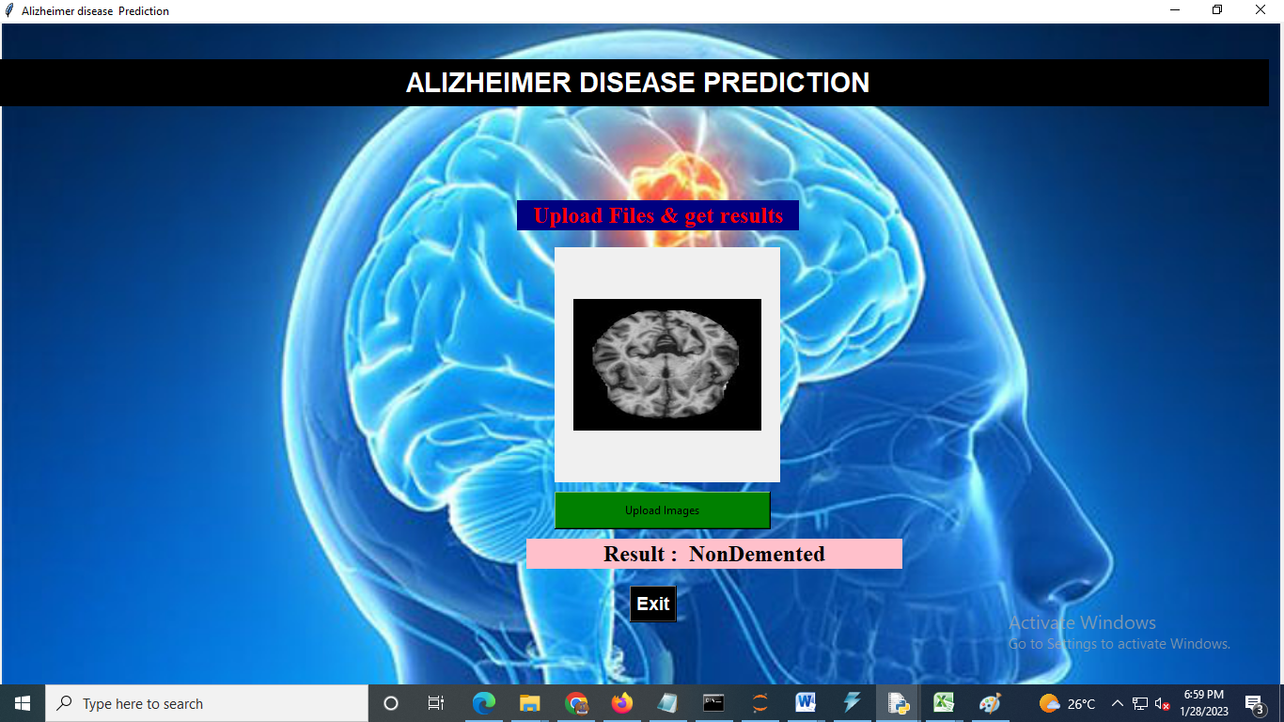

Slide 30


Slide 31
Conclusion :
In this paper we proposed a simple and robust classification approach of MRI scans for Alzheimer’s disease diagnosis. The approach is based on visual content description of anatomical structure of a brain region involved in AD ( hippocampal area). We proposed a late fusion of classification results on two biomarkers: hippocampus and CSF.
The experiments showed that combining hippocampus features and CSF amount classification gave better accuracy especially when discriminating between AD and MCI than when using either visual features or CSF volume separately for discriminating between AD and MCI than using either visual features extraction or CSF volume computation separately.
We also demonstrated that the proposed method provides better classification accuracy compared to other volumetric methods. In the perspective of this work we plan to use multiple ROIs, but also multiple MRI modalities in the established classification framework.

Slide 32
Future Work:
Far greater expert optimism exists about breakthroughs in AD in the next 20 years than in the prior 20 years. In our assessment, 10 breakthroughs were judged as being at least 70% likely to occur by 2037, whereas in our 2001 study no breakthrough was judged as being even 50% likely by 2021.
This optimism is reflected in the clinical pipeline for novel therapies, with a wide range of possibly disease-modifying biologics and small molecules now in Phase II and III clinical trials.
However, challenges remain in delivering the predicted new AD therapies to patients, ranging from the use of appropriate cognitive screening tools to the preparedness of national healthcare systems to diagnose and treat large numbers of potentially eligible patients.

Slide 33
References:
[1] Estimation of the Global Prevalence of Dementia in 2019 and Forecasted Prevalence in 2050: An Analysis for the Global Burden of Disease Study 2019, The Lancet Public Health, G. D. F. Collaborators, GBD, Dementia Forecasting Collaborators, 2019
[2] Y. Statsenko, T. Habuza, D. Smetanina, G. L. Simiyu, L. Uzianbaeva, K. Neidl-Van Gorkom, N. Zaki, I. Charykova, J. Al Koteesh, T. M. Almansoori, M. Belghali, and M. Ljubisavljevic, ‘‘Brain morphometry and cognitive performance in normal brain aging: Age- and sex-related structural and functional changes,’’ Frontiers Aging Neurosci., vol. 13, p. 687, Jan. 2021.
[3] X.-H. Hou, L. Feng, C. Zhang, X.-P. Cao, L. Tan, and J.-T. Yu, ‘‘Models for predicting risk of dementia: A systematic review,’’ J. Neurol., Neurosurg. Psychiatry, vol. 90, no. 4, pp. 373–379, Apr. 2019.

Slide 34
[4] S. Lahmiri and A. Shmuel, ‘‘Performance of machine learning methods applied to structural MRI and ADAS cognitive scores in diagnosing Alzheimer’s disease,’’ Biomed. Signal Process. Control, vol. 52, pp. 414–419, Jul. 2019.
[5] N. T. Duc, S. Ryu, M. N. I. Qureshi, M. Choi, K. H. Lee, and B. Lee, ‘‘3Ddeep learning based automatic diagnosis of Alzheimer’s disease with joint MMSE prediction using resting-state fMRI,’’ Neuroinformatics, vol. 18, no. 1, pp. 71–86, Jan. 2020.
[6] B. Lei, W. Hou, W. Zou, X. Li, C. Zhang, and T. Wang, ‘‘Longitudinal score prediction for Alzheimer’s disease based on ensemble correntropy and spatial–temporal constraint,’’ Brain Imag. Behav., vol. 13, no. 1, pp. 126–137, Feb. 2019.
[7] S. Walter, C. Dufouil, A. L. Gross, R. N. Jones, D. Mungas, T. J. Filshtein, J. J. Manly, T. E. Arpawong, and M. M. Glymour, ‘‘Neuropsychological test performance and MRI markers of dementia risk,’’ Alzheimer Disease Associated Disorders, vol. 33, no. 3, pp. 179–185, 2019.

Slide 35
[8] R. Rodríguez-Labrada, L. Velázquez-Pérez, R. Ortega-Sánchez, A. Peña-Acosta, Y. Vázquez-Mojena, N. Canales-Ochoa, J. Medrano-Montero, R. Torres-Vega, and Y. González-Zaldivar, ‘‘Insights into cognitive decline in spinocerebellar ataxia type 2: A P300 event-related brain potential study,’’ Cerebellum Ataxias, vol. 6, no. 1, p. 3, Dec. 2019.
[9] M. W. Vernooij, F. B. Pizzini, R. Schmidt, M. Smits, T. A. Yousry, N. Bargallo, G. B. Frisoni, S. Haller, and F. Barkhof, ‘‘Dementia imaging in clinical practice: A European-wide.survey of 193 centres and conclusions by the ESNR working group,’’ Neuroradiology, vol. 61, no. 6, pp. 633–642, Jun. 2019.
[10] P. Coupé, J. V. Manjón, E. Lanuza, and G. Catheline, ‘‘Lifespan changes of the human brain in Alzheimer’s disease,’’ Sci. Rep., vol. 9, no. 1, pp. 1–12, 2019.

Slide 36
[11] Lakshmi S V S S , Selvani Deepthi Kavila- “Machine Learning For Credit Card Fraud Detection System”, 2018.
[12] Andhavarapu Bhanusri- “Credit card fraud detection using Machine learning algorithms”, 2020.
[13] Pradheepan Raghavan, “Fraud Detection using Machine Learning and Deep Learning”, 2019.
[14] I.Sadgeli , N.Sael , F.Benabbou- “Performance of machine learning techniques in the detection of financial frauds”, 2019.
[15] Abdulalem Ali , Shukor Abd Razak , Siti Hajar Othman , Taiseer Abdalla Elfadil Eisa , Arafat Al-Dhaqm , Maged Nasser , Tusneem Elhassan , Hashim Elshafie and Abdu Saif- “Financial Fraud Detection Based on Machine Learning: A Systematic Literature Review”, 2022.

Slide 37
Thank You!

